Slide 1


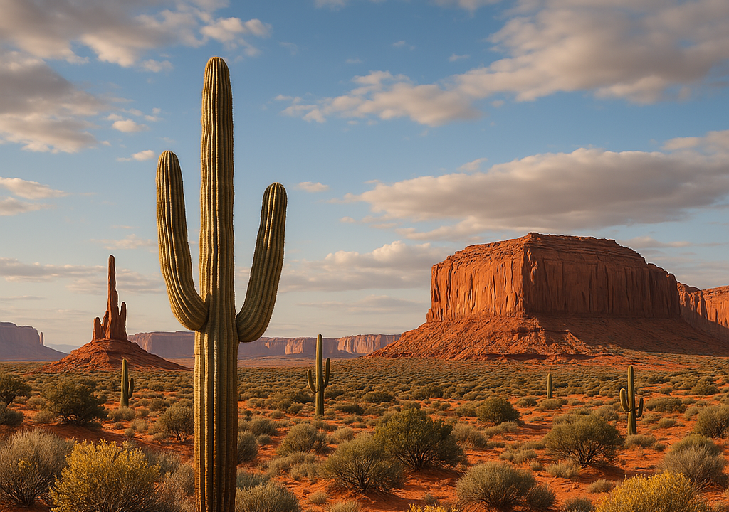
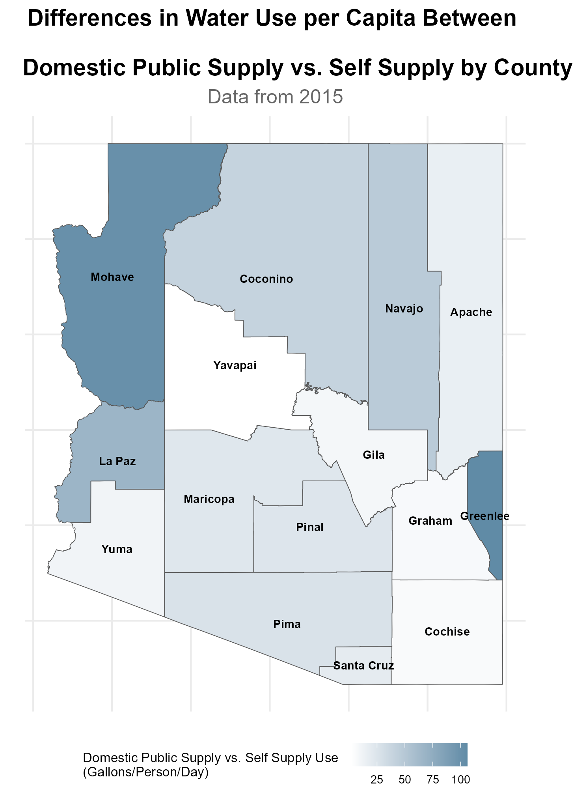
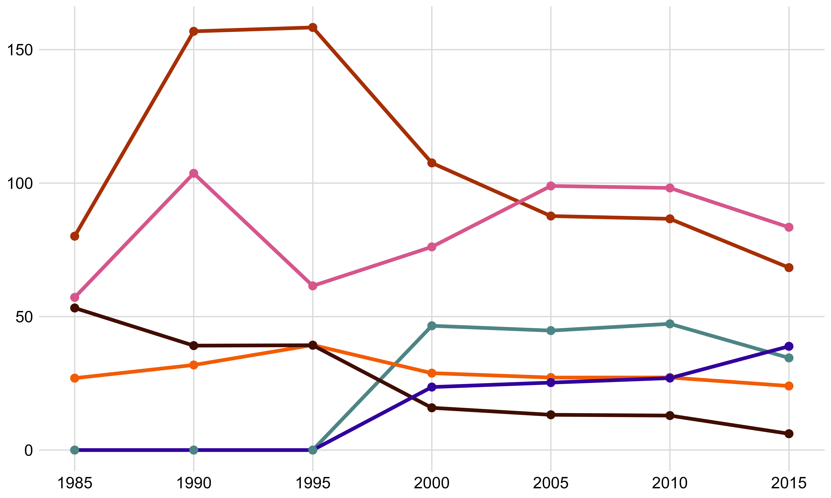
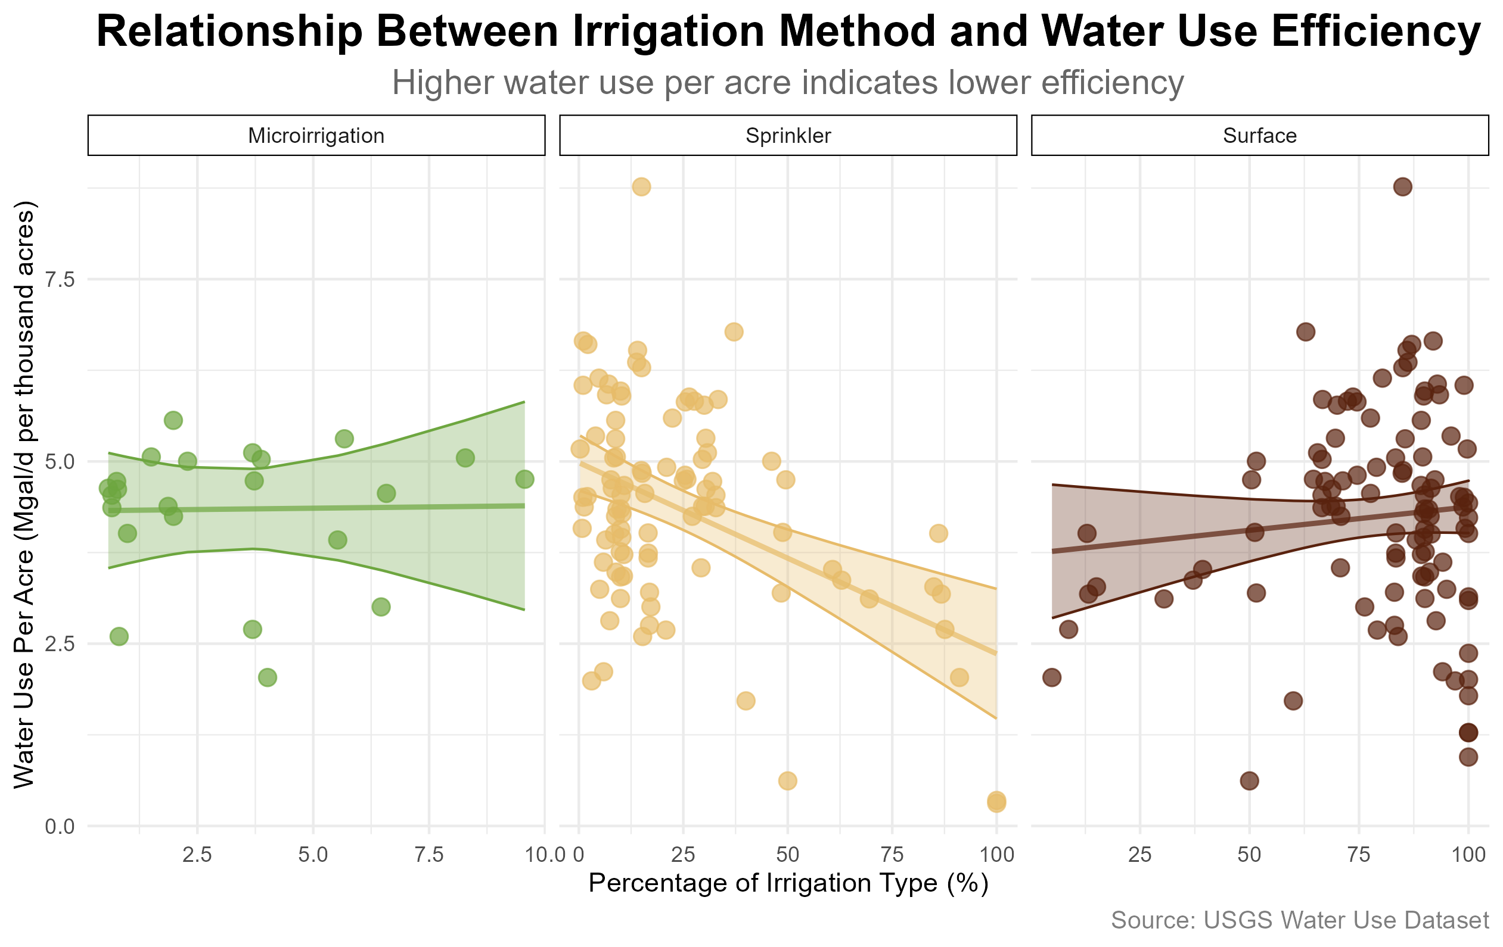
Arizona Water:
Jack Tomlon, Delila Medlin, Dr. Robert Buscaglia
The Pathogen and Microbiome Institute, Northern Arizona University, Flagstaff, AZ 86011
Our Problem
Analysis
Arizona is facing a critical water crisis due to a combination of prolonged drought, climate change, and overuse of water resources.
The Colorado River has experienced significant declines in runoff, leading to historically low reservoir levels in Lake Mead and Lake Powell.
In the past 20 years, these reservoirs' storage decreased by 33.5 million acre-feet, leaving total basin-wide storage sufficient to support average consumption for only 15 months.
Addressing these challenges requires substantial reductions in water use and the implementation of sustainable management practices to stabilize and recover water storage levels.
Discussion Here…
Abstract
As of March 2025, a staggering 99% of Arizona was in a state of drought (US Drought Monitor 2025).
Decreases in precipitation in our state have brought about concerns for the future of Arizona’s water future, and how the state is going to sustain their growing population and water consumption rates. This project analyzes water production and consumption data from the United States Geological Survey (USGS) to identify anomalies and investigate sectors exhibiting unusual water loss in Arizona. The data, collected from publicly available USGS resources includes information on water withdrawals, usage by sector, and sources such as surface and groundwater. The goal is to uncover patterns and discrepancies that may indicate inefficiencies or areas for improved water management. Additionally, this analysis explores the potential ethical and environmental benefits of increasing the use of reclaimed water within Arizona’s water management strategy. By identifying opportunities to optimize water use and integrate sustainable practices, the project aims to support more informed decision-making for managing Arizona’s limited water resources
effectively
Discussion
As the amount of Sprinkler irrigation increases, the water use per acre in a county decreases.
Because of the low amount of Microirrigation in the state, we can’t draw any conclusions about its efficiency through this set alone.
We found the majority of Arizona’s water is being used for irrigation of industrial agriculture. To further investigate this, we looking into the breakdown of irrigation methods in AZ, finding that surface irrigation is the main irrigation technique by far. In the industry it is well-known that though surface irrigation is cheap, its very inefficient. Sprinkler irrigation is the middle ground between cost and efficiency. Finally, microirrigation is the most expensive, but also most efficient method. Whilst we can’t just cut down on water use for agriculture vital to AZ’s economy, we can improve our efficiency within this sector.
One way AZ is trying to improve this through 42 USC 10364: Water Management Improvement Bill. This bill authorizes the Secretary (presumably of the Interior Department) to provide grants and enter into cooperative agreements with eligible applicants to improve water management. Though there are some issues with the bill.
Limited Tribal Considerations
Ceiling on how much funding can be received
Ambiguous language on what projects are prioritized
Looking forward:…
Proportion of Irrigation method in Arizona
Year | Sprinkler | Microirrigation | Surface
1985 | 19.92% | 0.00% | 80.08%
1990 | 20.65% | 0.00% | 79.35%
1995 | 18.54% | 1.32% | 80.13%
2000 | 21.15% | 1.39% | 77.46%
2005 | 24.75% | 2.15% | 73.10%
2010 | 19.64% | 2.83% | 77.53%
2015 | 24.21% | 5.53% | 70.27%
The proportion of Surface watering has slowly decreased since 1985.
Conversely, the proportion of Sprinkler and Microirrigation watering has increased slightly.
Analysis

